Slide 1
JK Global Infratrade

Slide 2
VISION
Infrastructure is the ongoing major drive of commerce and economy in South Asia and Africa over the next two decades. We will be an integrated trade-solution provider with primary focus on infrastructure verticals like Construction, Power, Oil and Gas, and bulk commodities.
MISSION
To be an Integrated Procurement/Supply-Chain arm offering high quality economic solutions for our esteemed clients

Slide 3
Introduction
OUR ESTABLISHMENT
We have a business development and marketing base in India, Mauritius, and Sri Lanka. A sourcing network in India, Malaysia, and China. Singapore is our Trade-banking center.
THE PEOPLE BEHIND IT
Our investors are motivated by the business potential of Infrastructure, power, and construction. All are highly accomplished individuals in their respective fields. The Operational team is a convergence of professionals from diverse backgrounds but with a common denominator in one or more of:
Infrastructure | Business Development | Sourcing-Procurement Supply-chain | Trading & International commerce.

Slide 4
About us
JK Global is an independent sourcing company and procurement consultancy.
With our head office in Mumbai, India and a strong network of associates in
Strategic locations, we are ideally placed to fulfill all kind of procurement
requirements from the Asian Sub Continent , especially from the Far East
regions of China, Taiwan, and Korea. We provide top-of-the-line services,
including fully comprehensive consultancy services, business outsourcing,
products, manufacturer sourcing, market research, practical in-market
assistance, and complete logistics and supply chain management services.
The services we provide ensure that our client's requirements are met from
the initial enquiry right through to final delivery. With extensive knowledge of
sourcing destinations and market situations, we have a proven track record of
helping companies source and buy a diverse range of products from our
associates. Being strategically placed across various locations, we ensure
quality as well as timely economic solutions.

Slide 5
Business Model
Participation in the growth of emerging economies by filling the P arm of EPC Space. Working with consortiums to get access to the opportunities in large Infra-Projects.
Procurement
“P”
State of the Art Web Portal for bringing together buyers and sellers and for physically serving trade-worthy cases – to be launched shortly
Projects
Infra Advisory
Logistics
JV
JV
Structured Trade & Project Finance

Slide 6
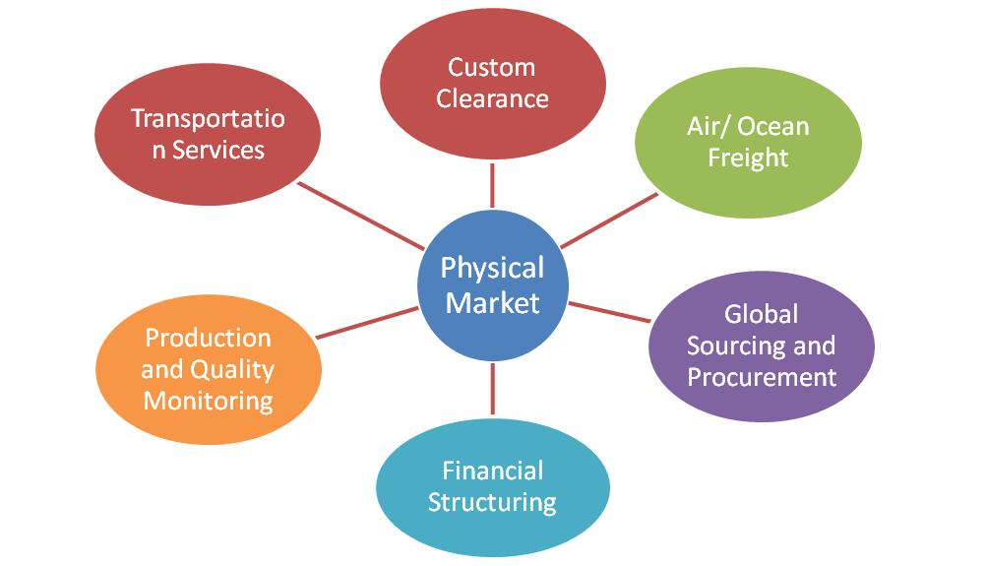
360 Degree Solution
Our Clients requirements are met right from the initial enquiry to final delivery, facilitating a one-stop-solution.

Slide 7
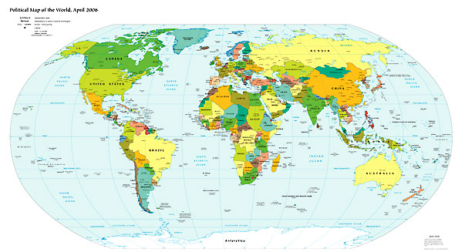
Our Locations
New Delhi
Marketing/Liaison
China
Sourcing
Mumbai
Marketing & Sourcing
Sri Lanka
Marketing
Singapore - Global HQ
Business Development
Malaysia
Sourcing
Mauritius & Africa
Marketing& Sourcing

Slide 8
We are …
Local
Focused marketing in
India
Sri Lanka
Africa
and Global
Sourcing from all over the world through
our own people and authorized Agents
Multiple
Regional Profit-centers
Indian Subcontinent
Mauritius and Africa
Sri Lanka
but Unified
Centralized Support-service
Sourcing
Finance
HR & Admin

Slide 9
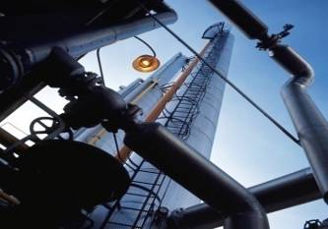
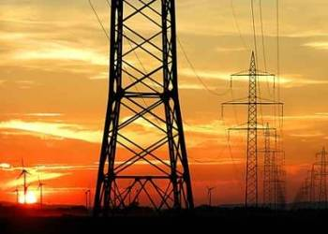
The Product Range
Construction
Interiors
Oil and Gas
Power
Bulk commodities
Trade Finance
Notes:
9

Slide 10
Construction
Construction equipments | Steel| Cement| Bulldozers | Concrete Mixers
Bitumen | Mobile Cranes | Forklifts | Tiles | Sanitary fittings
Tower Cranes | Dumpers | Glass| Metal Scrap
Notes:
10

Slide 11
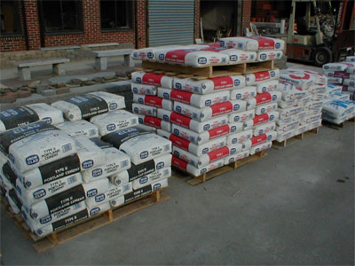
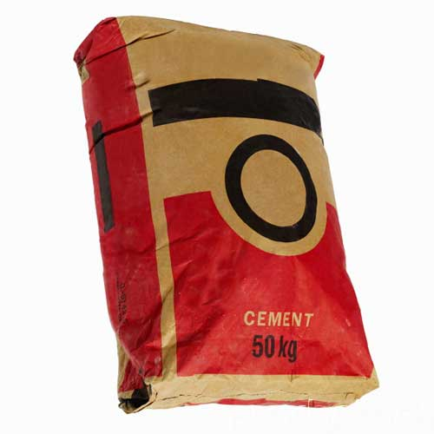
Cement
Notes:
11

Slide 12
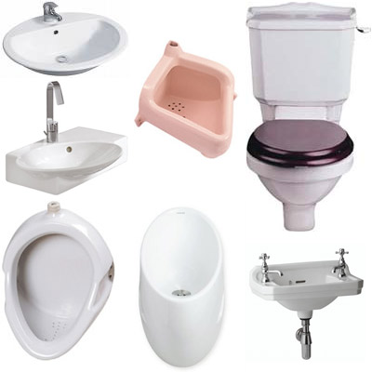
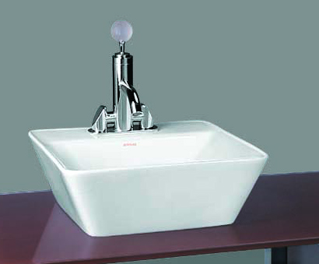
Sanitary Ware
Notes:
12

Slide 13
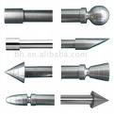
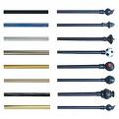
CASTERS, DOOR KNOBS, & HANDLES

Slide 14
Tiles & Marbles
Notes:
14

Slide 15
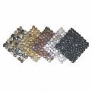
Tiles & Marbles
Notes:
15

Slide 16
Furniture
Office furniture| Hotel furniture |School and College furniture
|Kindergarden furniture |Furnishings | Accessories

Slide 17
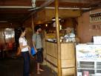
Hotel Reception Furniture

Slide 18
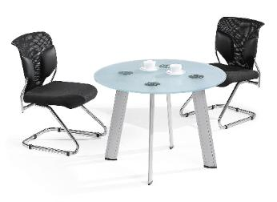
Office Furniture

Slide 19
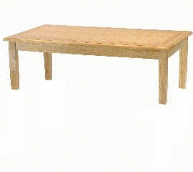
Hotel Furniture

Slide 20
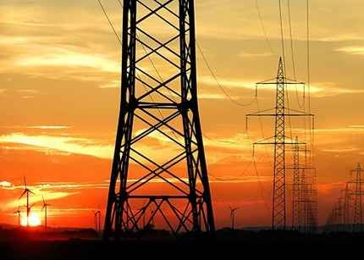
Power
Generators | Boilers | Turbines | Pre-heaters | Coal handling
Transformers | Control Relay Panels | Transmission Towers
Balancer plants | Steam coal| Filters | Ash handling
Notes:
20

Slide 21
Fertilizers & Chemicals
Rock Phosphate | DAP | MOP | MAP
Urea | Water soluble fertilizers | Phosphoric acid |Organic Fertilizers

Slide 22
Oil and Gas
Rigs | Barges Drilling equipments | Diesel |
Boats & Tugs | Furnace oil | Valves | Pipes and Casings

Slide 23
Bulk Commodities
Certain Agro products | Procurement consultancy
Logistics services | Metal scraps

Slide 24
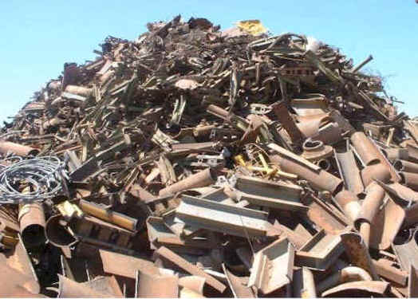
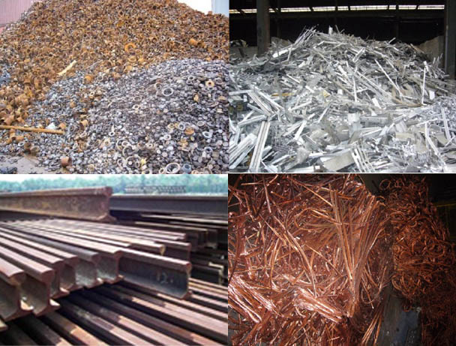
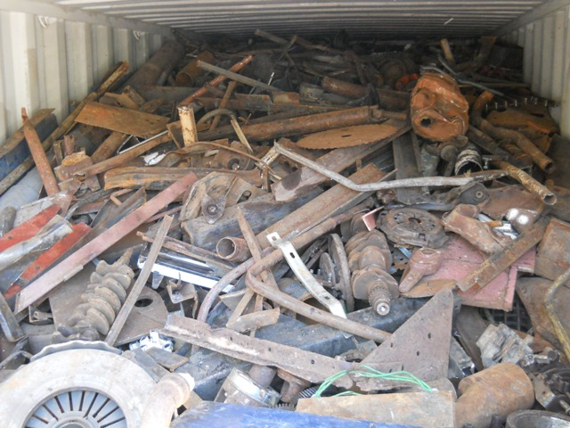
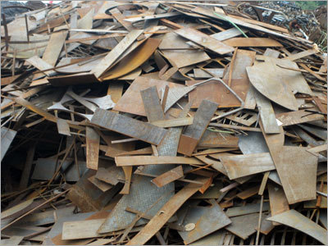
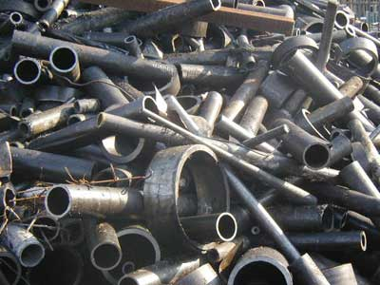
METAL SCRAPS

Slide 25
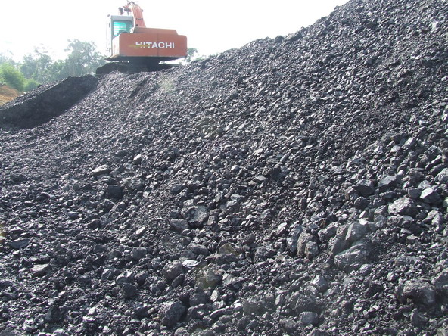
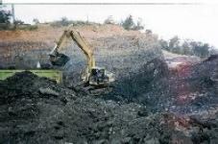
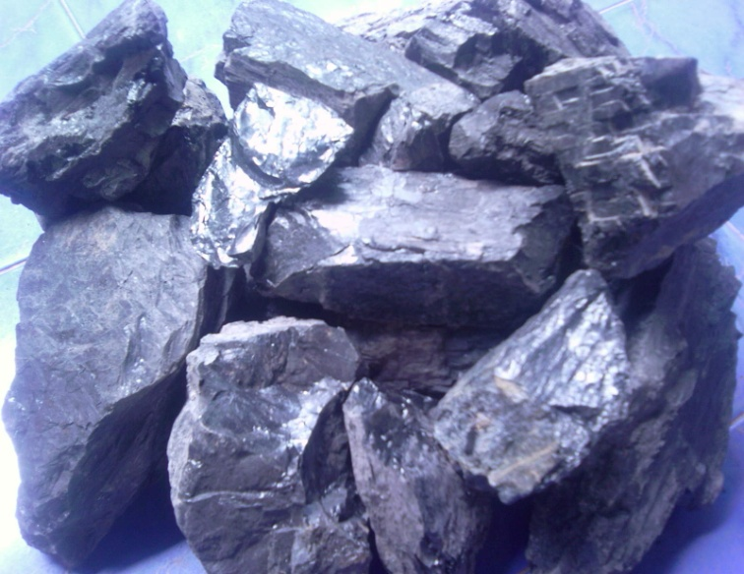
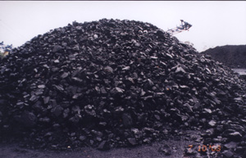
COAL

Slide 26
FINANCIAL SERVICES
The financial services division of JK Global Infratrade broadly provides:
Project debt and equity fund-raising
Import trade finance
Valuation management services.
Through its range of experience and its wide professional network. JK Global Infratrade provides resources, (including, but not limited to equity and or debt capital) for the execution and concluding of:
Business restructuring
Growth capital mobilization
Investment and transaction solutions
We also offer trade finance and fund syndication services in buyer’s credit financing and supplier’s credit at extremely attractive pricing from a consortium of international banks.
Clients engage JK Global Infratrade to help them to evaluate and vet bankable project reports, and business plans that help raise debt from NBFCs, Private Equity, and Private High Net worth Individual lenders.

Slide 27
FINANCIAL SERVICES
ADVANTAGES OF PARTNERING WITH JK Global Infratrade
Funding is cost effective
Funding is timely
Complete transparency
Effective and Efficient Operations
Valuable Experience with diverse Clientele across various verticals
PROFILE OF COMPANIES MOST BENEFITTED BY FINANCING
JK Global works with fast-growing business enterprises that are on a clear path to lift
their revenues and profits from a zone of marginal/normal growth and get on to the
breakout growth orbit.
VAST EXPERIENCE
Our partners, team-members and network of associates are specialists in their respective
fields with previous experience in corporate advisory, debt raising, restructuring, IPO, PE
and M&A transactions over the past two decades with a sound understanding of the global
and domestic financial markets.

Slide 28
FINANCIAL SERVICES/PRODUCTS OFFERED
Project Term Loans
ECBs
Buyer’s Credit/ Supplier’s Credit
LC Bills Discounting
Post Shipment Export financing
Debt Funding
Loan Against Property (LAP)
Arrangement of Trade Arbitrage options
Setting up limits for fund based/non fund based in India and abroad

Slide 29
Trade Finance
Trade Finance – Buyers Credit
It is arranged up to 1 year for Non - Capital Goods / 3 years for Capital Goods Imports.
It is an Import loan availed from International Banks for meeting import obligation on due date.
It is arranged under Letter of Undertaking (LOU) issued by the major Indian Banks.
It is Libor based and the rate does not exceed more than 200 basis points over 6 months LIBOR.
Thus, the importer gets substantial savings in finance costs.

Slide 30
Thank You

